Slide 1
Capstone Project : 1
Hotel Booking Analysis Team Members: Rahul Kumar Soni
Mouleena Jaiswal
Pisay Bharath Tanmay Bohra

Slide 2
Content
1. Problem Statement
2. Data Summary
3. Analysis of Data
4. Challenges
5. Conclusions

Slide 3
Problem Statements
1. What is the count of each types of hotels ?
2. Where do the guest come from ?
3. How much do guest pay for a room per night?
4. Which are the most busy month?
5. Which hotel type has highest number of cancellations?
6. Booking and cancellation per market segment ?
7. Which meals are more preferable ?
8. How long Guest stay at hotel on weekends and weekdays ?
9. How many repeated guests are there ?

Slide 4
Data Summary
The dataset spans over three years - 2015, 2016 and 2017.
1. 'hotel': Denotes the type of hotel - Resort hotel or city hotel
2. ‘country’: The country of origin of the customer; has 158 countries listed
3 .‘adr’: Average rental revenue earned for an occupied room per day
4. ‘reserved_room_type’: Code of room type reserved. Code is presented instead of designation for anonymity reasons.
5. ‘arrival_date_month’ : The month the customer arrived at the hotel
6. ‘is canceled’: Denoted by '1' if booking was cancelled or '0' otherwise

Slide 5
Data Summary
7. ‘market_segment’: A group of people who share one or more common characteristics, lumped together for marketing purposes
8. ‘meal’:Type of meal booked. Undefined/SC – no meal package; BB – Bed & Breakfast; HB – Half board (breakfast and one other meal – usually dinner); FB – Full board (breakfast, lunch and dinner)
9. ‘stays_in_weekend_night’:No of weekend nights (Sat/Sun) the guest stayed or booked to stay at the hotel
10.‘stays_in_week_night’:No of week nights (Mon - Fri) the guest stayed o
11.‘is repeated guest’: Denoted by '1’ if guest repeated or '0' otherwise

Slide 6
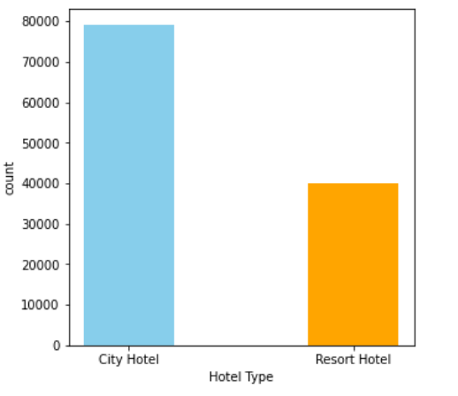
What is the count of each types of hotels ?
Out of 119390 Hotel bookings City hotel has 79329 bookings which is 66.4% whereas 40061 Resort bookings makes 33.6%. Here by Count of City Hotel Bookings are more when compared to Resort Hotel.

Slide 7
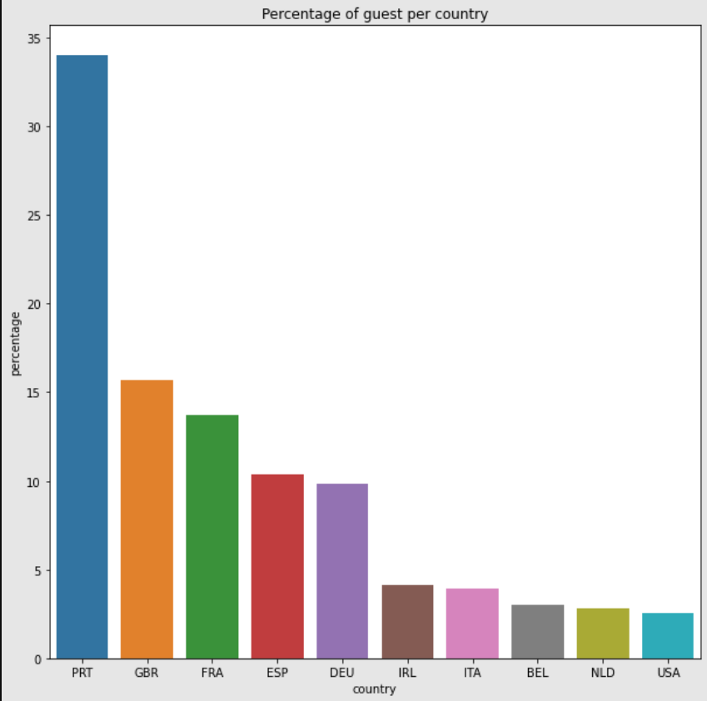
Where do the guest come from ?
This graph represent the top 10 countries from where guest comes and As per the graph most number of guests come from Portugal(PTR) followed by Great Britain(GBR) and France(FRA).

Slide 8
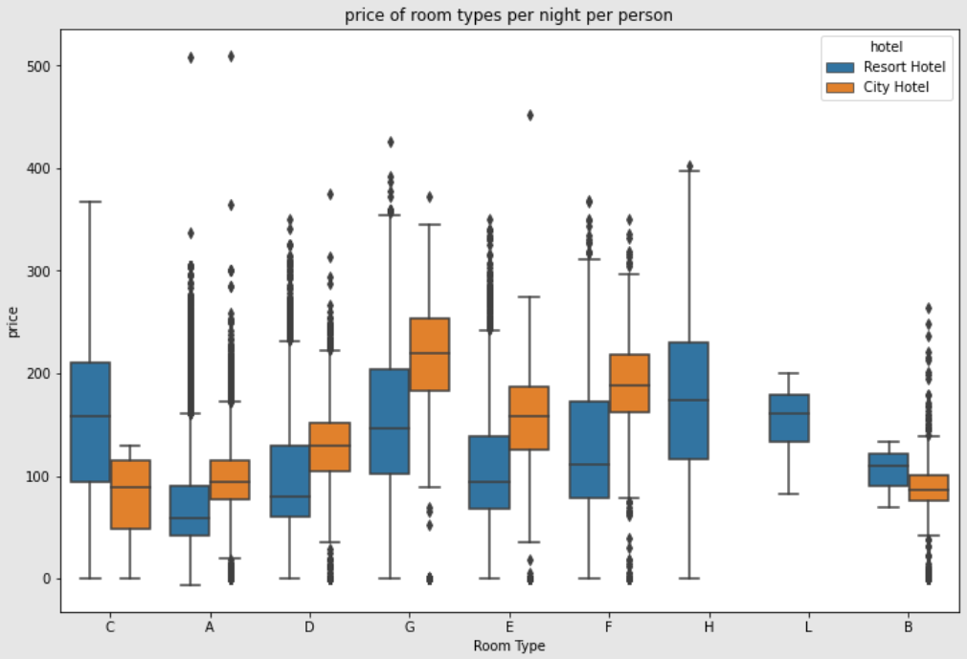
How much do guest pay for a room per night?
In the given boxplot there are 9 different types of rooms available and from those variety of room types Room Type G in both City Hotel and Resort Hotel is Costlier when compared to other Room Types.

Slide 9
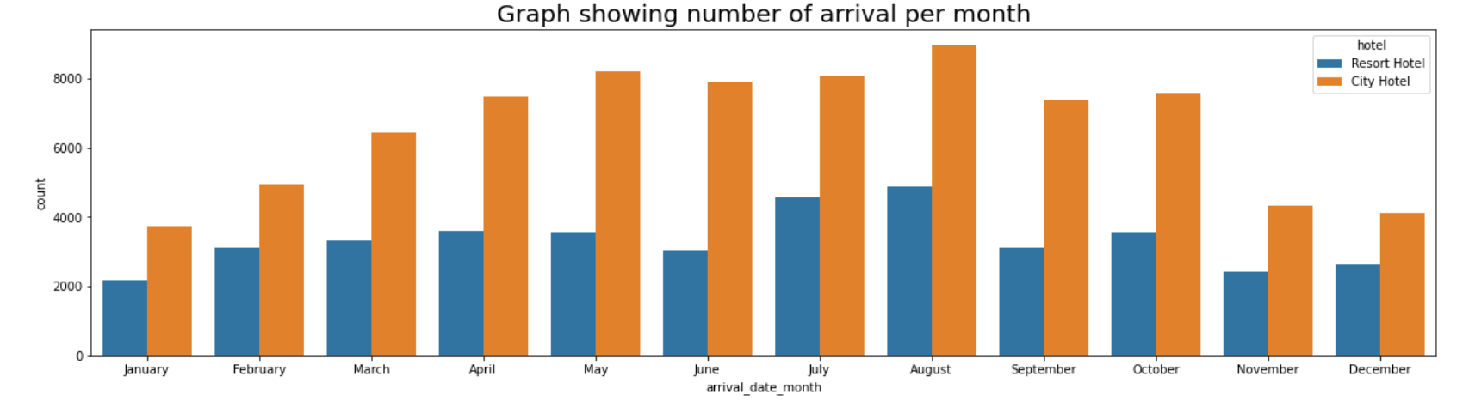
Which is the most busiest month?
By looking at the graph the bookings for both City and Resort Hotel are very high in the month of August.

Slide 10
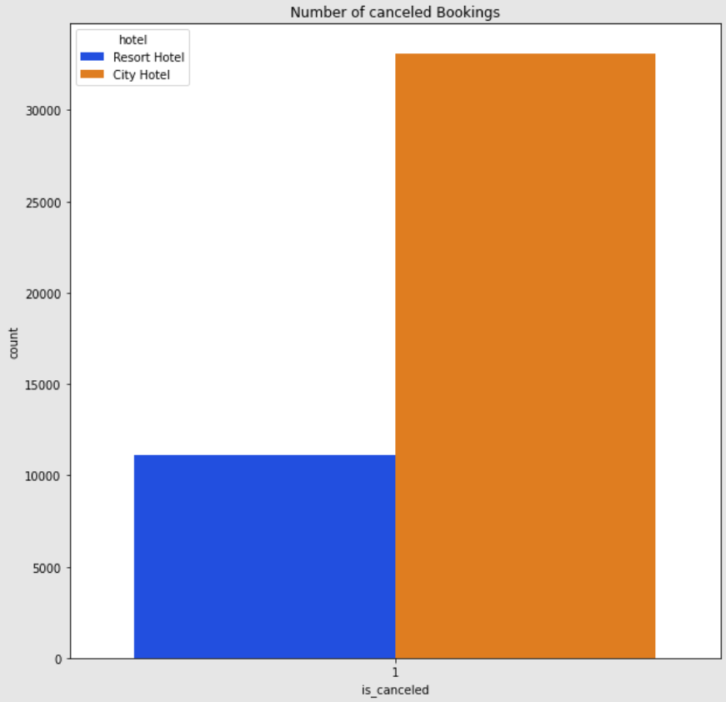
Which hotel type has highest number of cancellations ?
By looking at the graph City hotel has greater number of cancellations as compared to Resort Hotel.

Slide 11
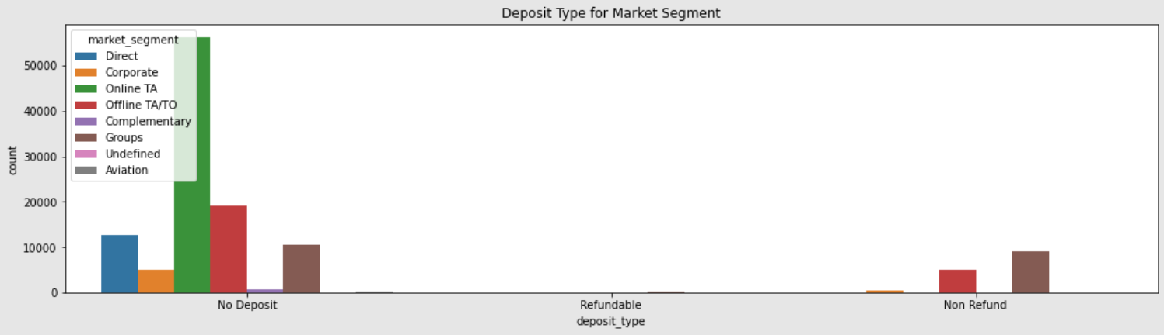
Bookings deposit per market segment?
From above graph online TA cover the highest market segment for booking deposit

Slide 12
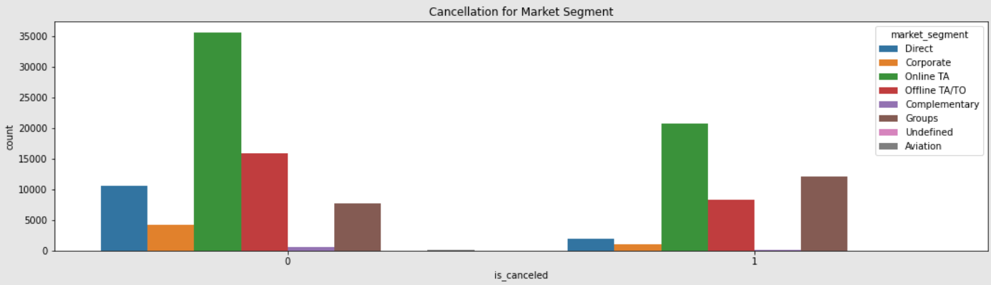
Cancellations per market segment?
We can also see that most Hotel Booking were cancelled through Online TA
te

Slide 13
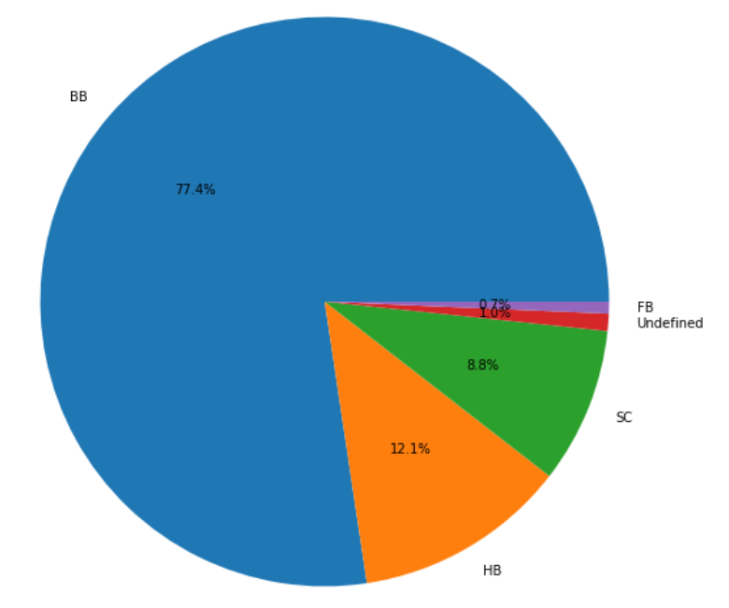
Which meals are more preferrable?
By looking at the pie chart the most preferred meal is BB which is Bed and Breakfast of 77.4% and the least preferred meal is FB which is Full Board of 0.7%.

Slide 14
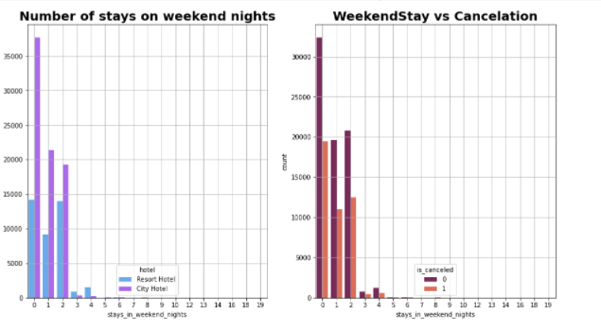
How long Guest stay at hotel on weekends night
More number of people prefer to stay at city Hotel in weekend for 0,1 and 2 night. People staying for more than 2 night prefer to stay at Resort hotel.
We can also see that we have less number of booking cancellation for weekends booking

Slide 15
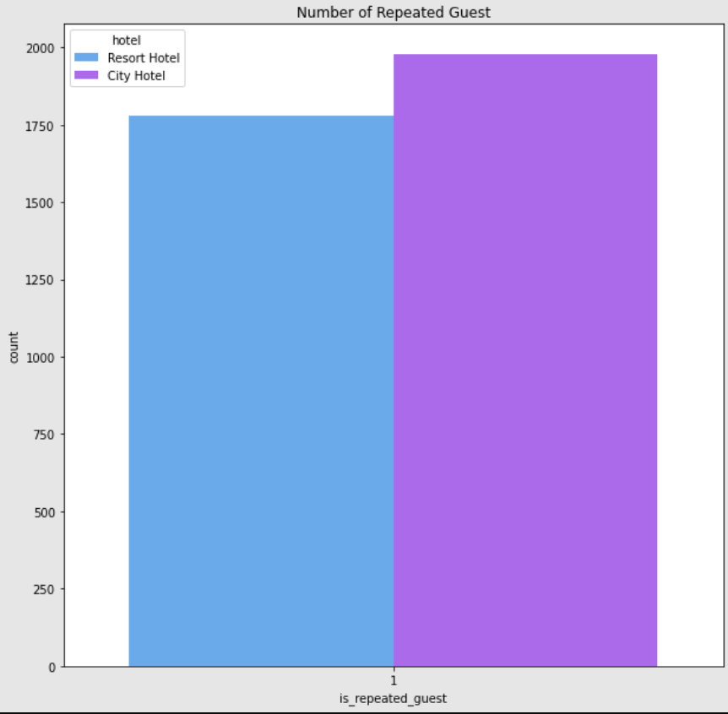
How many repeated guests are there?
There are slightly a greater number of repeated guest in city hotel than resort hotel.

Slide 16
Challenges:
1. Time taken to Identifying Problem Statements
2. Data Cleaning
3. Consideration of data subsets
4.Finding Suitable plots

Slide 17
Conclusions:
1. Resort hotels tend to have less bookings in comparison to city hotels so they need to work on their marketing strategy and promote the hotels more, especially on social media.
2.Resort hotels could also reduce prices to increases booking percentages. May-August happens to be the busiest months but so the hotels should target more customers and try to do more business during these times.

Slide 18
Conclusions:
3. Although city hotels have more bookings, they also tend to have more cancellations so to prevent this they could take advance money during vacation. This would ensure most bookings to not being cancelled. They could also apply minimum charge policies or make the refund policies rather strict so the customers choose not to cancel.
4.We also realize that the high rate of cancellations can be due high no deposit policies. Given that we do not have repeated guests, we should target our advertisement on guests to increase returning guests

Slide 19
Conclusions:
5. Given that hotels do not have more repeated guests, hotels may implement extra benefits offer for repeated guest, to attract them.

Slide 20
Q & A

